Slide 1
South Australian Crime Rate effect on median House Price 2015 -2020
Chevrolet Chilis
Annabel Cheong, Kylie Burns, Miki Cai, Nick Sullivan, Presit Kaur
Notes:
Kylie

Slide 2
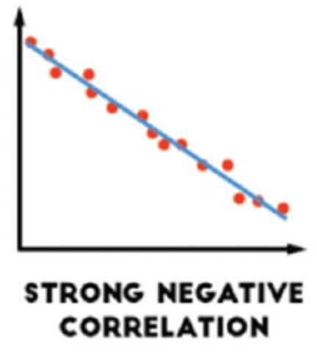
Motivation & PROJECT HYPOTHESIS
Project hypothesis:
Rates of crime against property directly effects median house price
Motivation:
Relevant to Australian audience ,in terms of crime and property ownership
One of the determining factors when purchasing a house
Analysis:
Analysis was based on:
South Australian Suburbs
5 most recent financial years
Property related crimes
Notes:
Will Crime rates will be higher for suburbs with lower median property prices
Will Crime rates will be lower for suburbs with higher median property prices
Will theft have the highest rate
Expect negative correlation with r-value of close to the value -1.0

Slide 3
Data SOURCES
Crime Data Source:
South Australian Government https://data.sa.gov.au/data/dataset/crime-statistics
Property Price Source:
South Australian Government https://data.sa.gov.au/data/dataset/metro-median-house-sales
Notes:
Elaborate on the questions you asked, describing what kinds of data you needed to answer them, and where you found it
Challenges:
Started looking at WA, found crime data from Crime Statistics | Western Australia Police Force was not broken down by location sufficiently to compare to the median house price with a commonality
During the slide talk about:
Crime Data Source
Five csv files (incorporated all crimes for five financial years)
Each row contained the committed crime date, suburb, crime count and crime type
Data from a reliable source, could have trust

Slide 4
DATA SOURCE DEFINITIONS – CRIME DATA
For the project analysis, CSV files were imported into pandas to create DataFrames for this raw data. The SA government file incorporated all types of crimes, but for our analysis we only selected five categories. These five categories are:
Other theft : Description: Theft except motor vehicles
Other property damage and environmental
Theft from motor vehicle
Serious Criminal Trespass – Residence
Theft/Illegal Use of Motor Vehicle
Why did we select these 5 categories?
These categories were believed to have the most impact on the hypothesis, directly effecting house price. The crime categories overlooked were more related to commercial property and petty crime.
Notes:
Nick to complete
Other theft : Description: Theft except motor vehicles
The unlawful taking or obtaining of money, goods or services other than or from motor vehicles, without the use of force, threat of force or violence, coercion or deception, with the intent to permanently deprive the owner or possessor of the use of the money or goods.
Other property damage and environmental
The wilful and unlawful destruction, damage or defacement of public or private property or the pollution of property or a definable entity held in common by the community. For this division 'destruction' means altering the property in any way so as to make it imperfect or inoperative.
Theft from motor vehicle
The taking of another person's property other than a motor vehicle, illegally and without permission with the intent of temporarily depriving the owner or possessor of the use of the property.
SCT – Residence.
The unlawful entry of a structure with the intent to commit an offence where the entry is either forced or unforced.
Theft/Illegal Use of MV
The taking of another person's motor vehicle illegally and without permission with the intent of either temporarily or permanently depriving the owner or possessor of the use of the motor vehicle. The taking of another person's motor vehicle parts or its contents illegally, whether or not this also involves the taking of the motor vehicle.
Trying to eliminate petty crimes (e.g. graffiti)
Included SCT because we assumed it would only be counted once and the data would be accurate
Describe the exploration and cleanup process
Crime data found in CSV by financial year, concate the data together for each year
Trial and error throughout data process
Binning the data
Discuss insights you had while exploring the data that you didn't anticipate
Discuss any problems that arose after exploring the data, and how you resolved them
Present and discuss interesting figures developed during exploration, ideally with the help of Jupyter Notebook

Slide 5
DATA SOURCE DEFINITIONS – PROPERTY DATA
Raw data was collected from data.sa.gov.au
This data was provided as quarters for each financial year and contained irrelevant columns and cells with NaN values
Quarters were merged into financial years after irrelevant columns and NaN cells were removed
After respective financial year data frames were grouped by suburb using the “groupby” function for data frames
Notes:
Presit
One excel document per quarter, a lot of data to merge
Lots of NaN in the combining of the data due to quarterly data – Median
Finding the best way to merge data (concat vs merge)
All Nan were dropped

Slide 6
DATA SOURCE DEFINITIONS – PROPERTY DATA
For the project analysis, raw data in excel was imported into a Jupyter Notebook for the creation of property-related Panda DataFrames.
The median price of the raw data is available for each quarter (for the past five financial years)
In order to determine if there is a correlation between crime counts and property prices, one property price value was used for each financial year. This was was the mean of the four quarterly prices of each financial year
The city and suburbs were provided for each property sale. Only the suburb column was used to merge between the crime DataFrame and the property price DataFrame
Notes:
One excel document per quarter, a lot of data to merge
Lots of NaN in the combining of the data due to quarterly data – Median
Finding the best way to merge data
All Nan were dropped

Slide 7
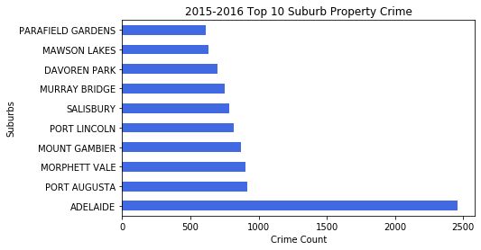
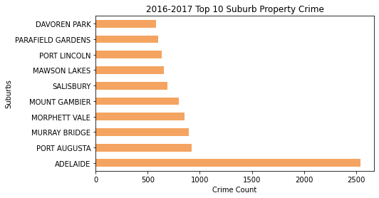
Data AnalysiS TOP 10 SUBURBS BY CRIME COUNT
Notes:
Annabel
Adelaide (#1 for the whole time)
Port Augusta (decrease over period)
Morphett Vale (consistent)
Mount Gambier (consistent)
Port Lincoln (increased in last 2 years)
Salsibury (consistent)
Murray Bridge (decreased after three years at #3)
Davoren Park (only in first three years)
Mawson Lakes (consistent)
Parafield Gardens (consistently low)
Whyalla Norrie (only appears twice)
Prospect (only appears once)

Slide 8
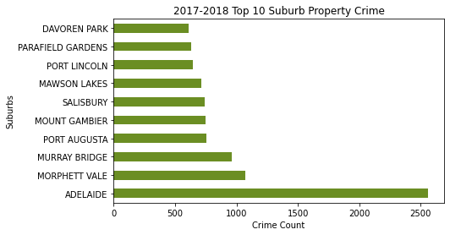
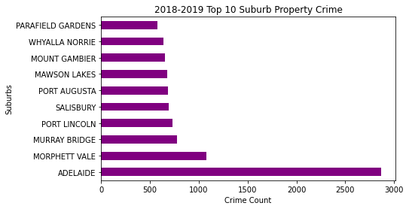
Data AnalysiS TOP 10 SUBURBS BY CRIME COUNT
Notes:
Annabel

Slide 9
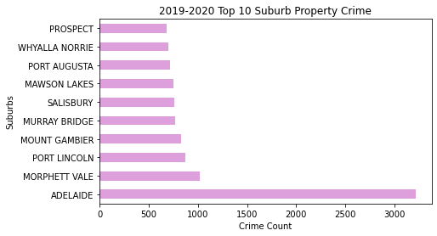
Data AnalysiS TOP 10 SUBURBS BY CRIME COUNT
2019-2020 Financial Year
Suburb | Crime Ranking (Ranking 1: highest crime count) | Property Price Ranking (Ranking 1: most expensive)
Adelaide | 1 | 66
Morphette Vale | 2 | 296
Port Lincoln | 3 | 293
*Total Suburbs = 325
Notes:
Annabel
In this bar chart, 8 of these suburbs remain in the Top 10 Crime Count suburbs over the past 5 years. (ie. The Top 8 in 2019-2020 existed in the top 10 for the past 5 financial years)
Adelaide
Morphette Vale
Port Lincoln
Mount Gambier
Murray Bridge
Salisbury
Mawson Lakes
Port Augusta
Of the top 3 crime count suburbs, based on our hypothesis, high crime rates correlates to low property prices, the highest committing crime suburbs should be the cheapest. (ie. Lowest ranking) (eg. 325th ranking for Adelaide is what is expected from the hypothesis)

Slide 10
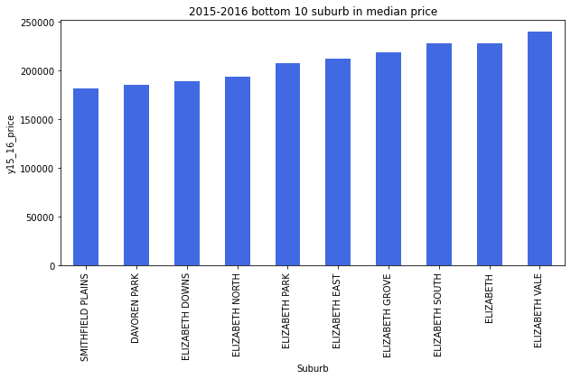
Data AnalysiS Bottom 10 SUBURBS BY PROPERTY PRICE
Smithfield Plains
Davoren Park
Elizabeth Downs
Elizabeth North
Elizabeth Park
Elizabeth East
Elizabeth South
Elizabeth
Elizabeth Vale
Notes:
Miki
Insert graphs
Insert insights – list suburbs that are in the top 10 over the past five financial years

Slide 11
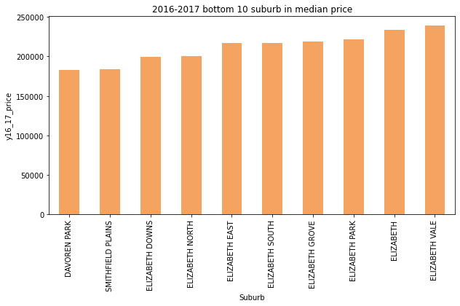
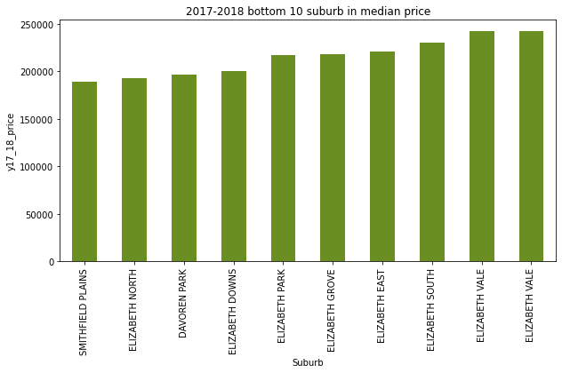
Data AnalysiS Bottom 10 SUBURBS BY PROPERTY PRICE
Notes:
Miki
Missing 2016 -2017 chart

Slide 12
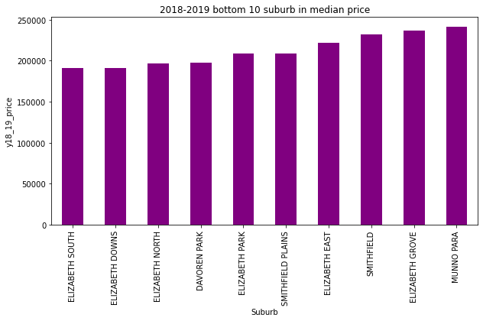
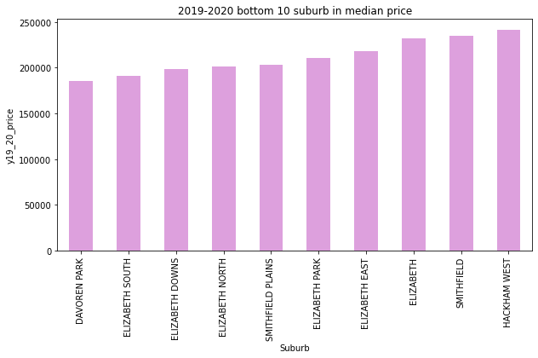
Data AnalysiS Bottom 10 SUBURBS BY PROPERTY PRICE
Notes:
Miki

Slide 13
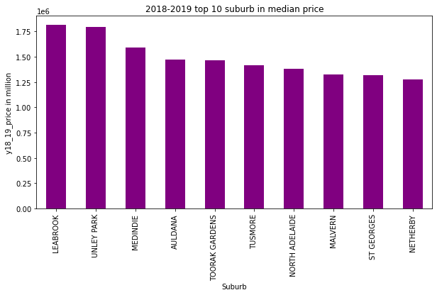
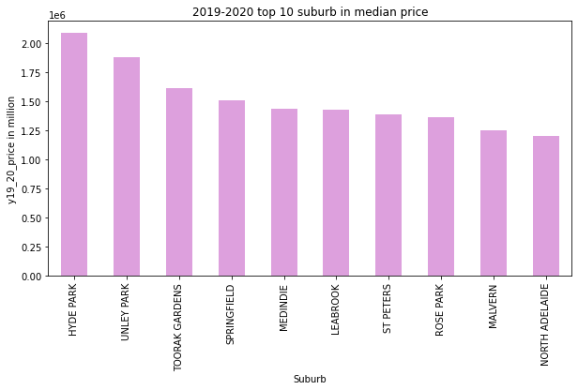
Data AnalysiS TOP 10 SUBURBS BY PROPERTY PRICE
2019-2020 Financial Year
Suburb | Property Price Ranking (Ranking 1: most expensive) | Crime Ranking (Ranking 1: highest crime count)
Hyde Park | 1 | 279
Unley Park | 2 | 267
Toorak Gardens | 3 | 233
*Total Suburbs = 325
Notes:
Miki

Slide 14
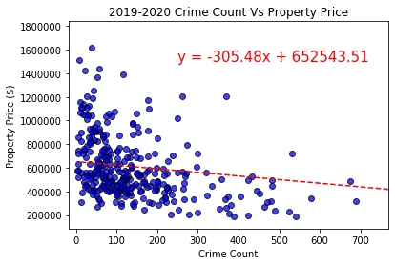
Data AnalysiS Correlation between crime count and property price
2019/20:
Coefficient: -305.48
R-squared value: 0.05
Negative relationship between crime count and property price in all five financial years analysed
Weak correlation as indicated by r-squared value
Possible explanations for weak correlation:
Other variables affecting property price
Data not adjusted to account for variance in population between suburbs
Reject alternative hypothesis
Notes:
Nick

Slide 15
PROJECT CHALLENGES
Challenges
Initially data for Western Australia was considered however there was no common column to combine the two data frames on
Raw crime data was sorted by dates and not yearly quarters
Determining how to find an appropriate property value to represent the financial year as only quarterly median prices were provided in the raw data
Given Additional Project Time
Dropped all rows with data that was not available (NaN)
Explore other variables affecting property prices
Further analysis into crime types versus crime count and property prices
Notes:
Presit – Challenges
Nick – Additional project time

Slide 16
Questions

Slide 17
Must complete for the project:
The technical requirements for Project 1 are as follows.
Use Pandas to clean and format your data set(s)
Create a Jupyter Notebook describing the data exploration and cleanup process
Create a Jupyter Notebook illustrating the final data analysis
Use Matplotlib to create a total of 6-8 visualizations of your data (ideally, at least 2 per "question" you ask of your data)
Save PNG images of your visualizations to distribute to the class and instructional team, and for inclusion in your presentation
Optionally, use at least one API, if you can find an API with data pertinent to your primary research questions
Create a write-up summarizing your major findings. This should include a heading for each "question" you asked of your data, and under each heading, a short description of what you found and any relevant plots.

Slide 18
Must Complete for Presentation
The presentation requirements for Project 1 are as follows.
Your presentation must:
Be at least 8-10 min. long
Describe the core message or hypothesis for your project.
Describe the questions you and your group found interesting, and what motivated you to answer them
Summarize where and how you found the data you used to answer these questions
Describe the data exploration and cleanup process (accompanied by your Jupyter Notebook)
Describe the analysis process (accompanied by your Jupyter Notebook)
Summarize your conclusions. This should include a numerical summary (i.e., what data did your analysis yield), as well as visualizations of that summary (plots of the final analysis data)
Discuss the implications of your findings. This is where you get to have an open-ended discussion about what your findings "mean".
Tell a good story! Storytelling through data analysis is no different than in literature. Find your narrative and use your analysis and visualization skills to highlight conflict and resolution in your data.

